Slide 1

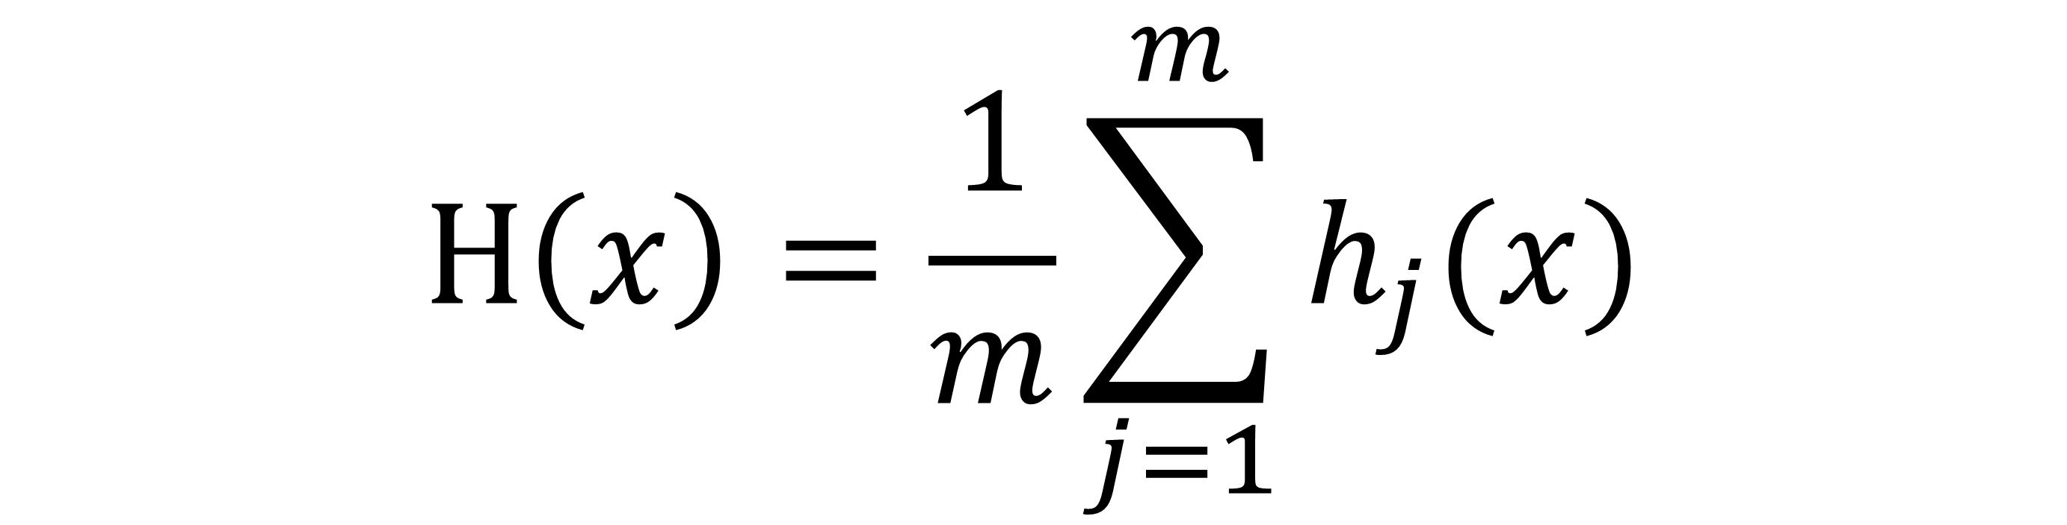
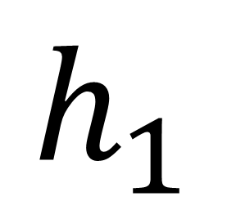


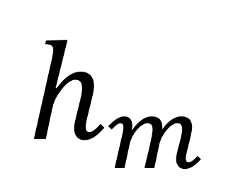
$$…$$
$$…$$
$$h_{1}$$
$$h_{j}$$
$$h_{m}$$
$$H\left(x\right)=\frac{1}{m}\sum_{j=1}^{m}{h_{j}(x)}$$

